Slide 1
Exploratory Data Analysis
By
Aditya Verma

Slide 2
Exploratory Data Analysis (EDA) :
Exploratory Data Analysis (EDA) is an approach to analyze the data using visual techniques. It is used to discover trends, patterns, or to check assumptions with the help of statistical summary and graphical representations.
Data visualization
Data Visualization is the process of analyzing data in the form of graphs or maps, making it a lot easier to understand the trends or patterns in the data. There are various types of visualizations –
Univariate analysis: This type of data consists of only one variable. The analysis of univariate data is thus the simplest form of analysis since the information deals with only one quantity that changes. It does not deal with causes or relationships and the main purpose of the analysis is to describe the data and find patterns that exist within it.
Bi-Variate analysis: This type of data involves two different variables. The analysis of this type of data deals with causes and relationships and the analysis is done to find out the relationship among the two variables.
Multi-Variate analysis: When the data involves three or more variables, it is categorized under multivariate.

Slide 3
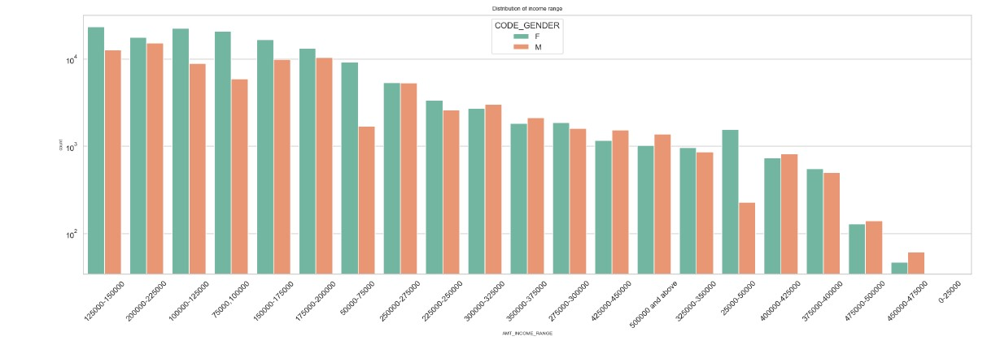
Univariate Analysis of Categorical and Numerical Data
Checked for clients that are likely to be defaulters/ unlikely to pay back the loan by analysing various columns in the data frame.
Based on CODE_GENDER (gender of client)

Slide 4
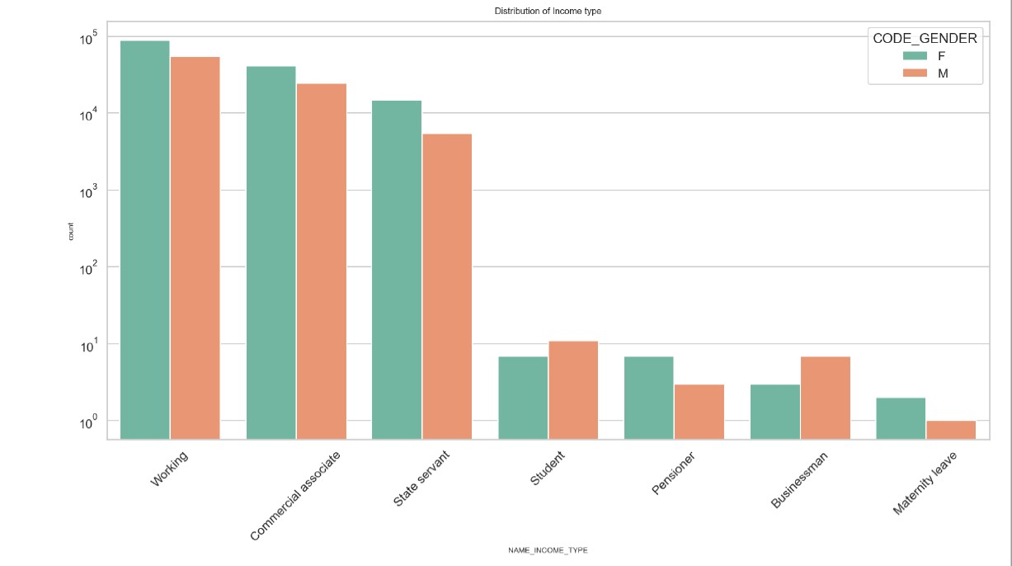
Distribution of income type :
Code gender male & female ,working state servant & student

Slide 5
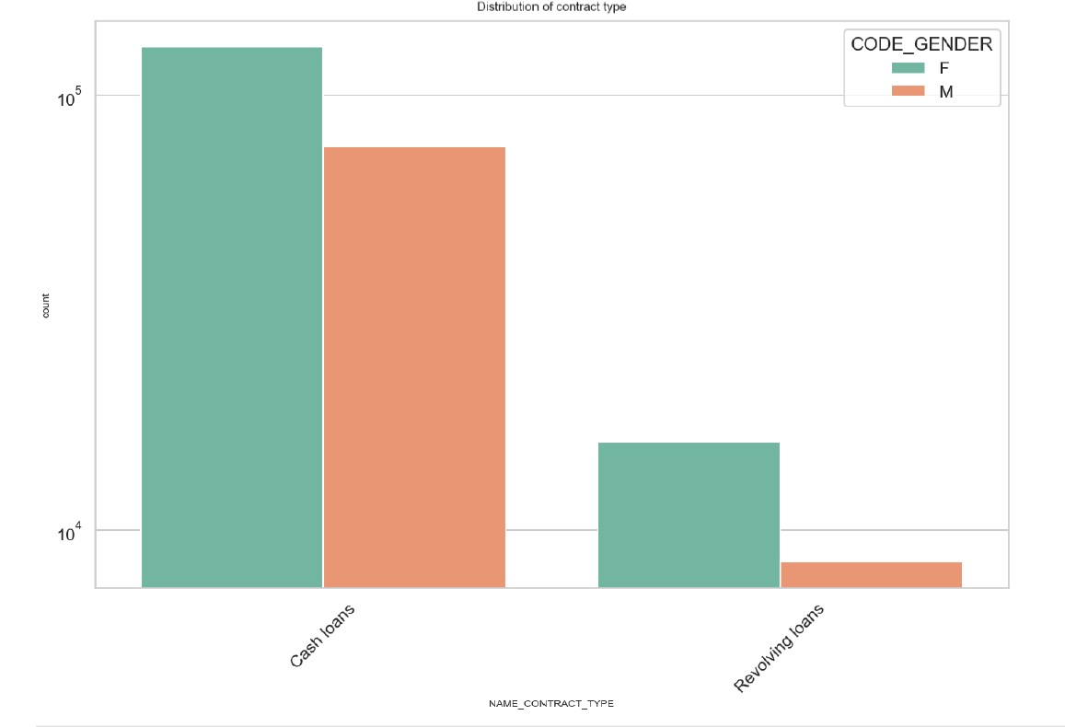
Distribution of contract type via cash loans to revolving loans

Slide 6
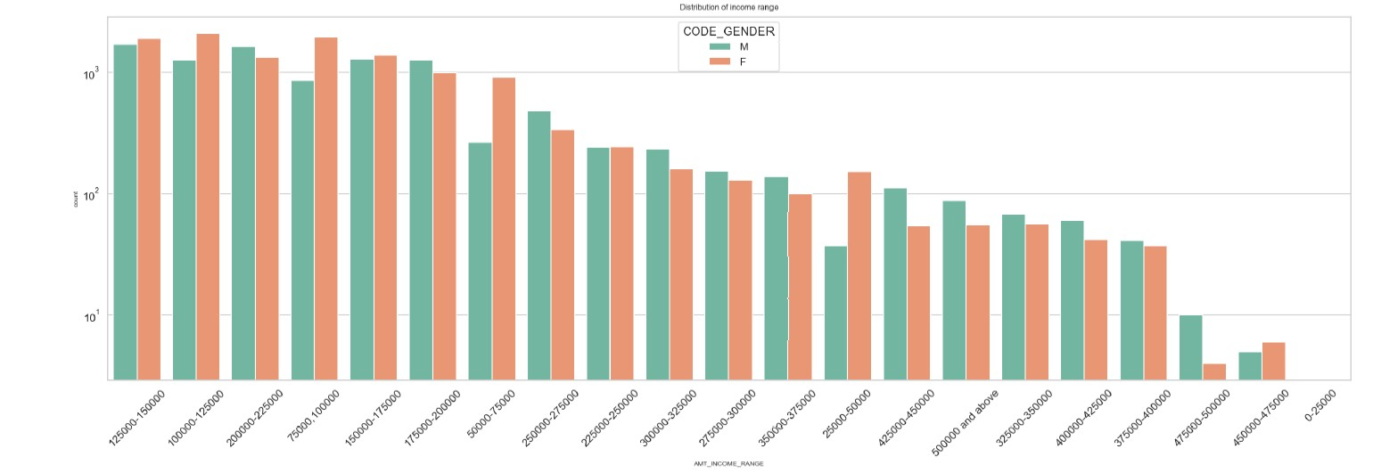
Distribution of income range :

Slide 7
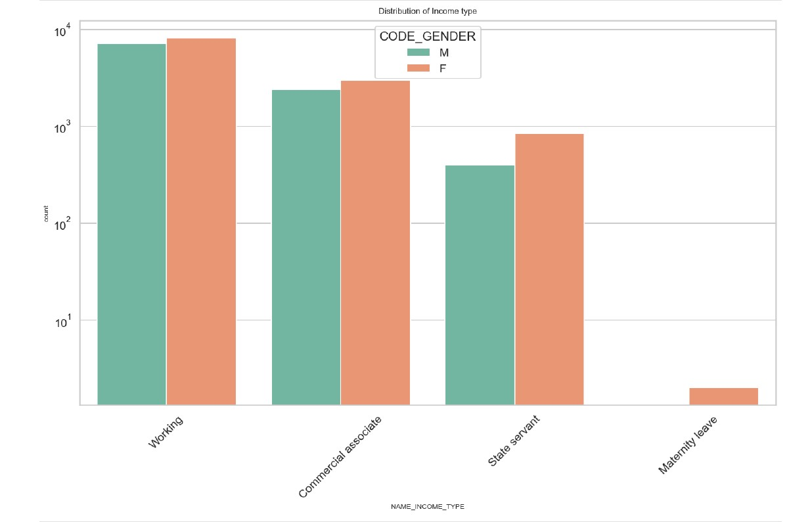
Distribution of income type:
Working , commercial associate & maternity level

Slide 8
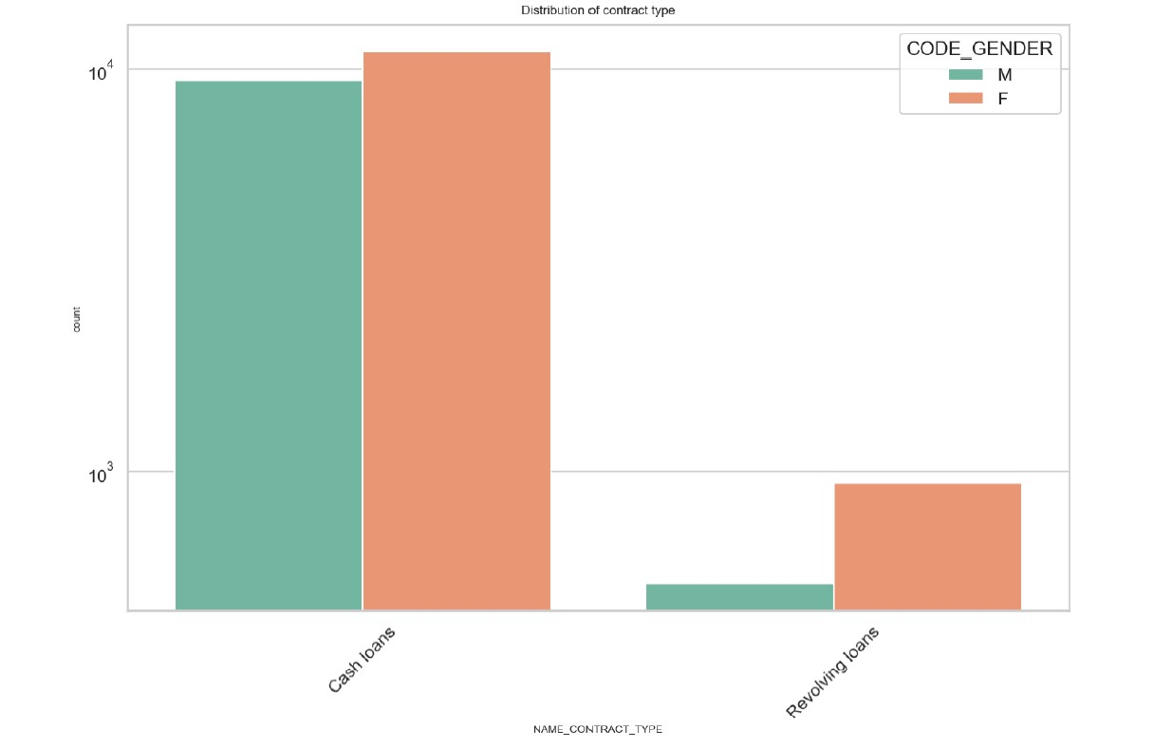
Distribution of contract type :
Cash loans & revolving loans

Slide 9
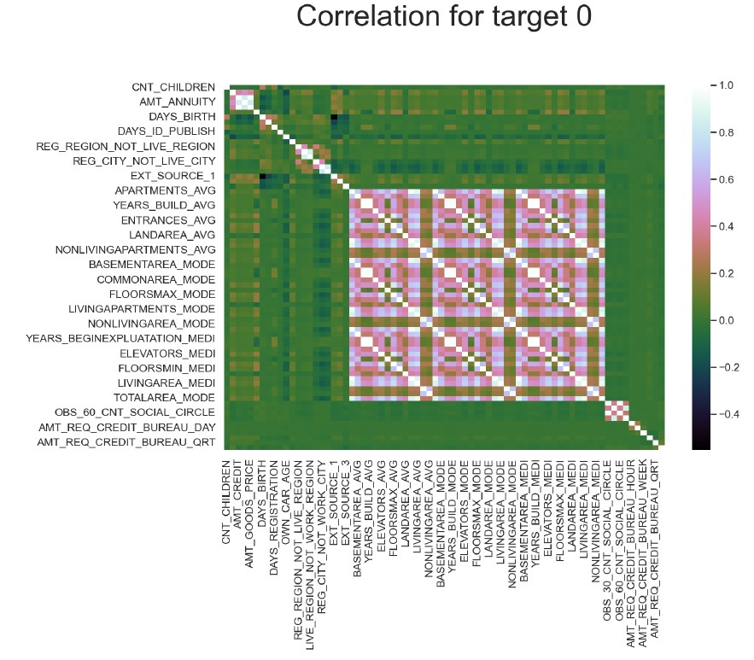
Correlation for target:

Slide 10
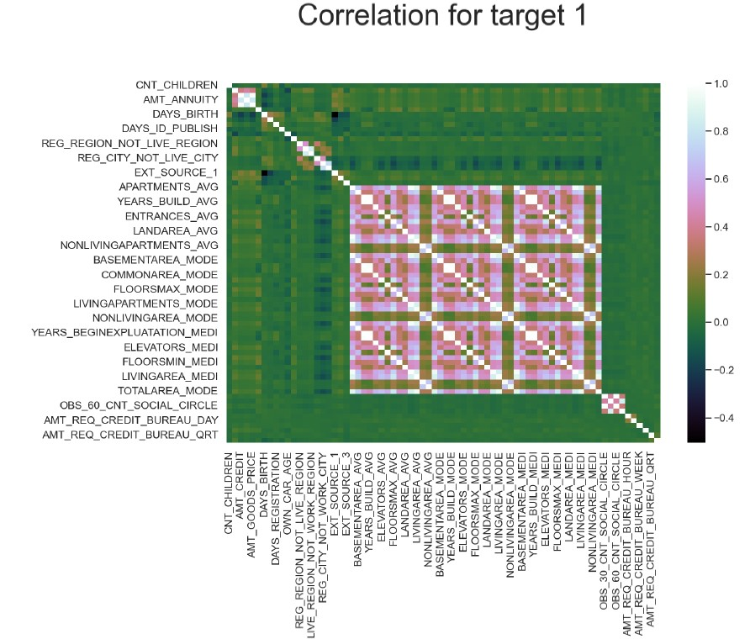
Correlation for target:

Slide 11
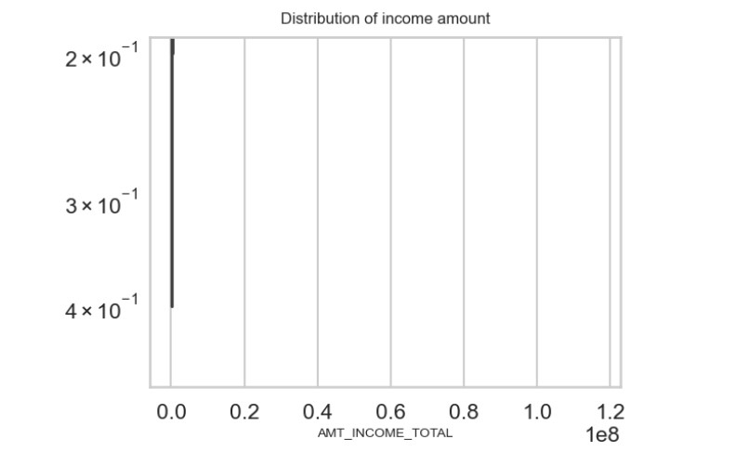
Income amount distribution

Slide 12
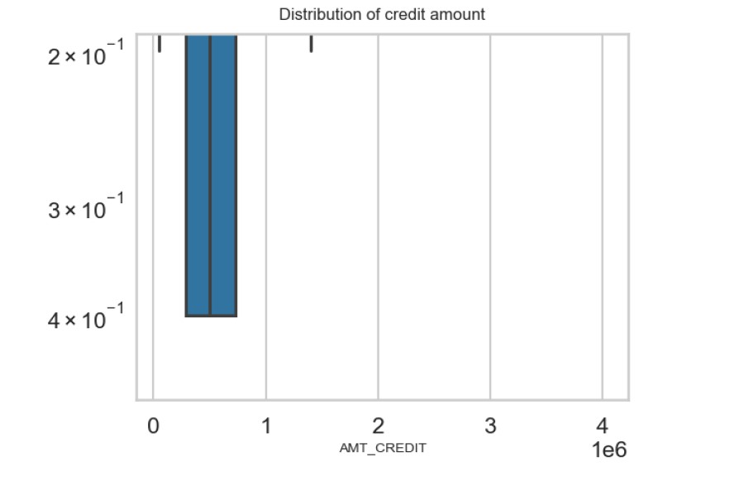
Credit amount distribution:

Slide 13
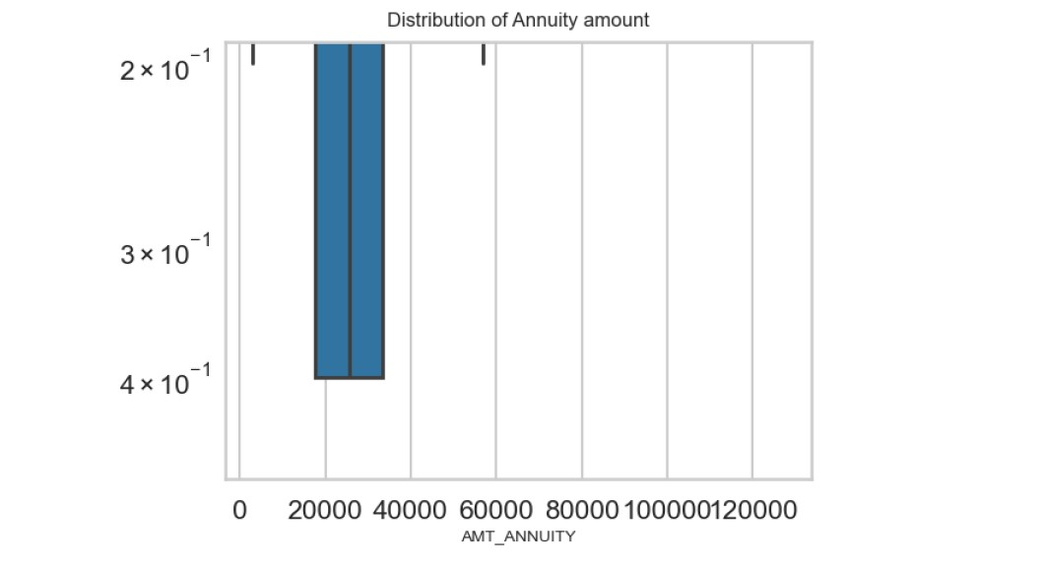
Distribution of annuity amount

Slide 14
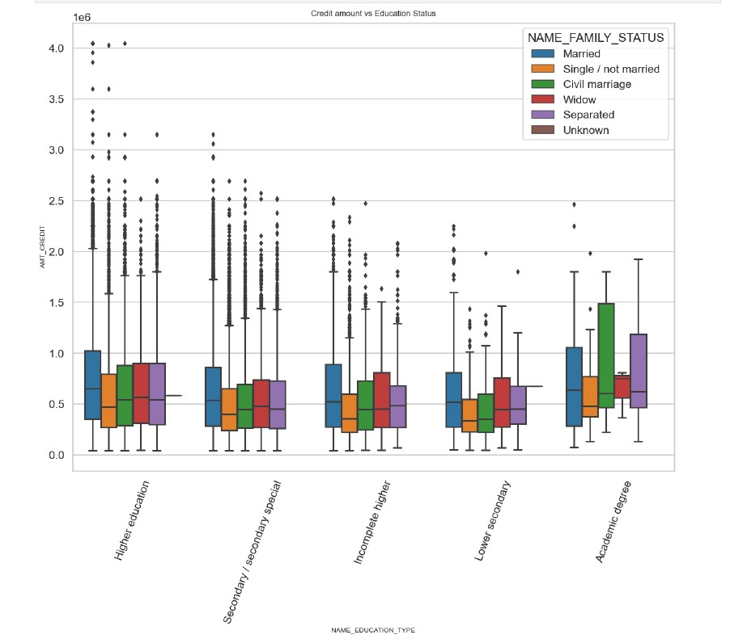
Credit amount vs
Credit amount vs education status: higer education

Slide 15
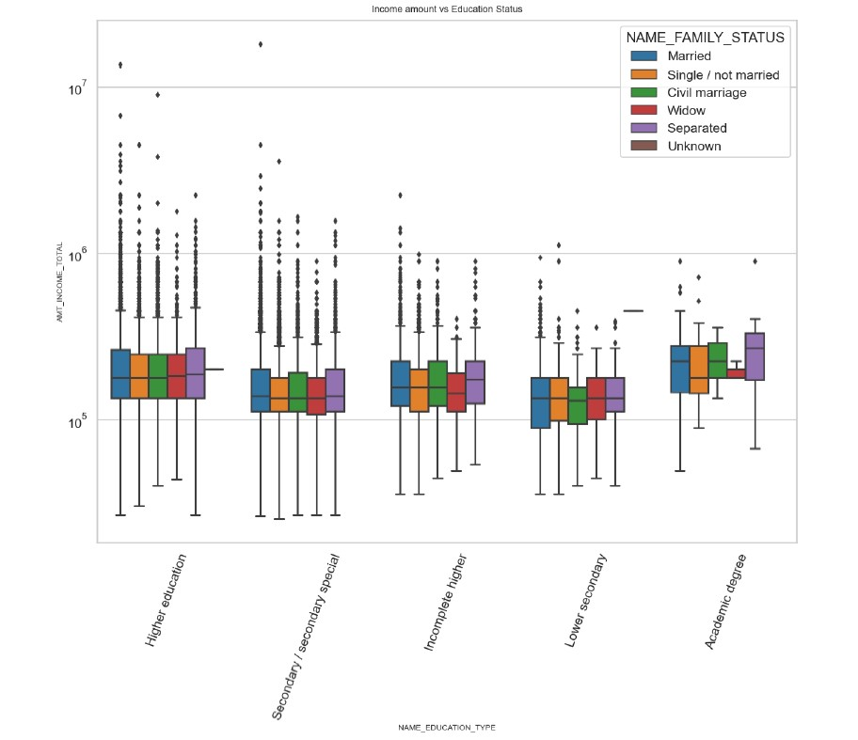
Income amount to education status

Slide 16
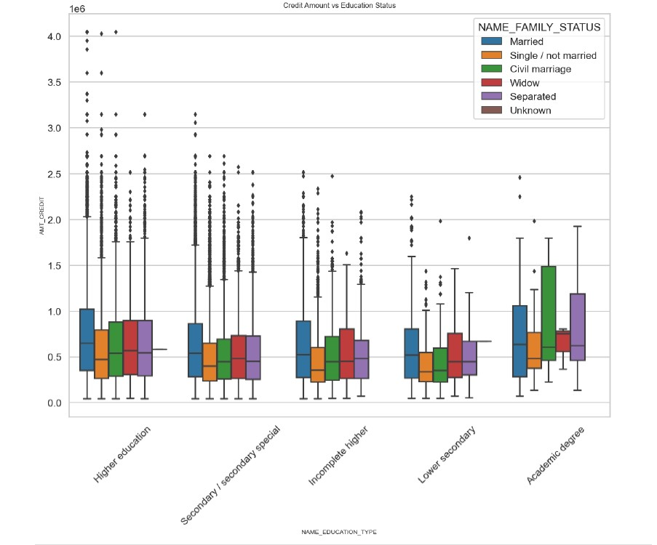
Credit amount to education status

Slide 17
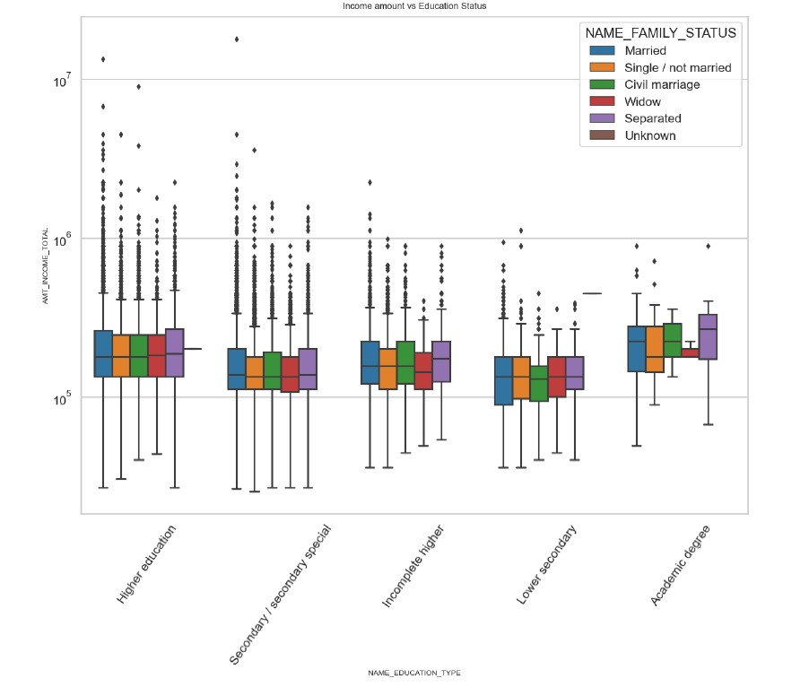
Income amount to family status

Slide 18
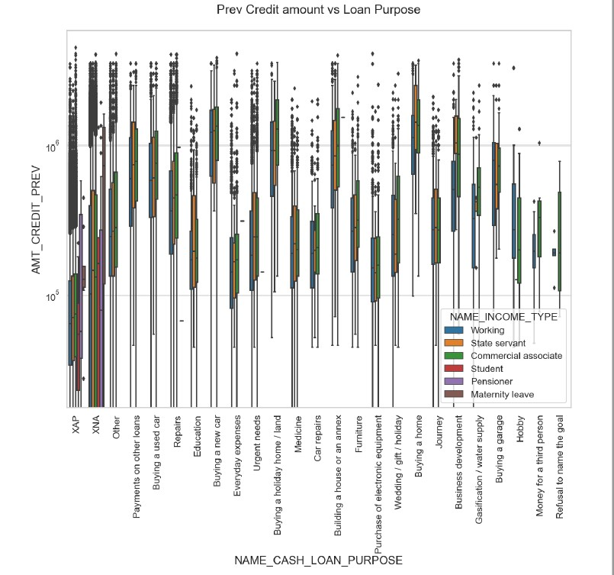
Prev credit amount and loan purpose

Slide 19
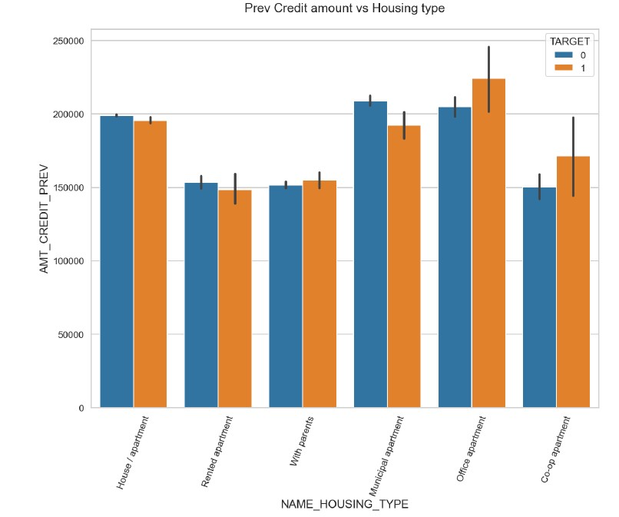
Credit amount to housing type

Slide 20
THANK YOU

